Slide 1

THE UNIVERSITY OF DA NANG
DA NANG UNIVERSITY OF SCIENCE AND TECHNOLOGY
FACULTY OF INFORMATION TECHNOLOGY
PROJECT TITLE :
BUILDING THE WEB SYSTEM CONNECTING FOOTBALL TEAMS
Instructor : Pham Cong Thang, Ph.D.
Student : Le Anh Tuan
Student ID : 102140230
Class : 14TCLC2
<number>
Notes:
<number>

Slide 2
agenda
Introduction
Project Overview
Technologies
Conclusion
Demonstration
<number>

Slide 3
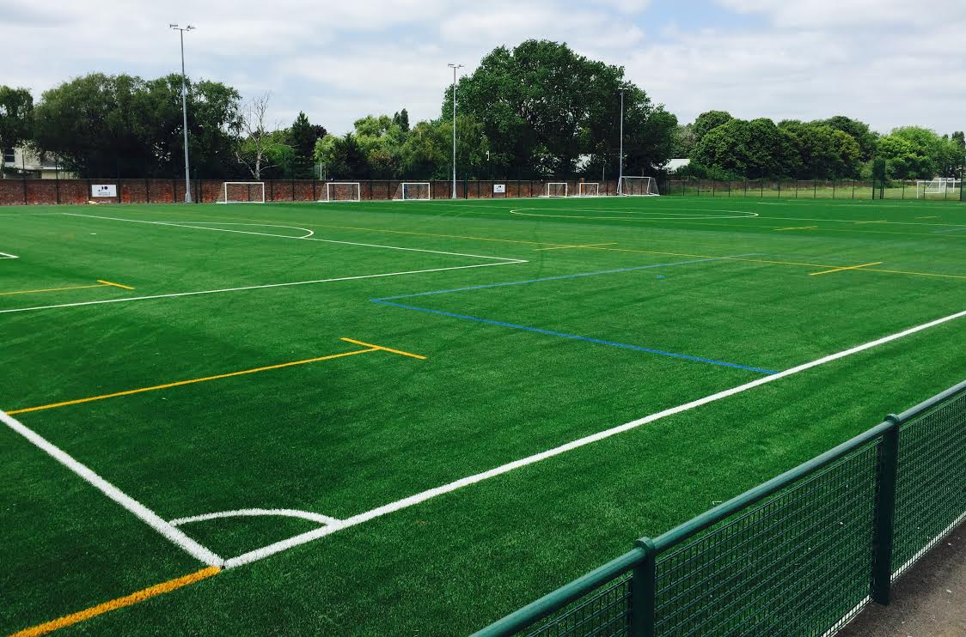

Introduction
Where is this idea from?
How can I find?
<number>
Notes:
<number>

Slide 4
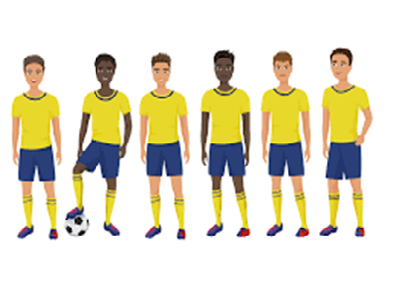
Introduction
Have any opening league???
Connect with other teams???
How to join the available league???
Have any team available at the weekend???
<number>
Notes:
<number>

Slide 5
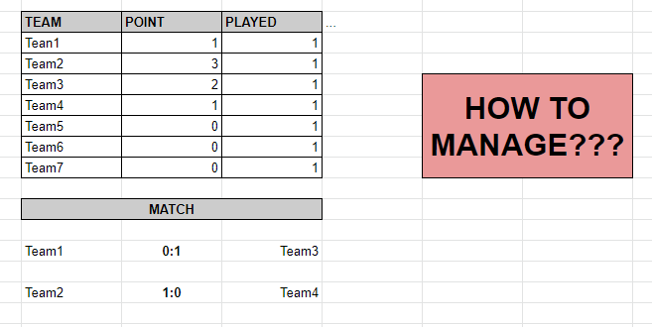
Introduction
<number>
Notes:
<number>

Slide 6
Introduction
My system will resolve some issues:
- Supporting the users to search the gridirons.
- Supporting the users to search and to pair the matches.
- Supporting the users to search and to join the leagues.
- Supporting the users Manage the leagues, the gridirons, the teams, the matches...
<number>
Notes:
<number>

Slide 7
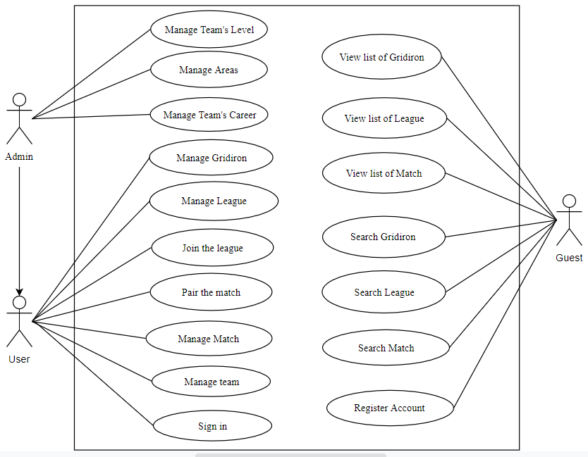
Project overview
<number>
Notes:
illustrative images
<number>

Slide 8
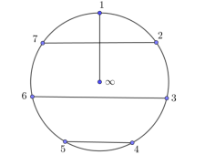
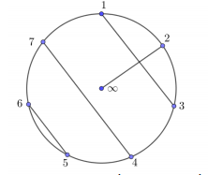
Project overview
Some main feature:
Search the available matches, the available league.
Pair the match.
Generate league’s schedule.
<number>
Notes:
illustrative images
<number>

Slide 9
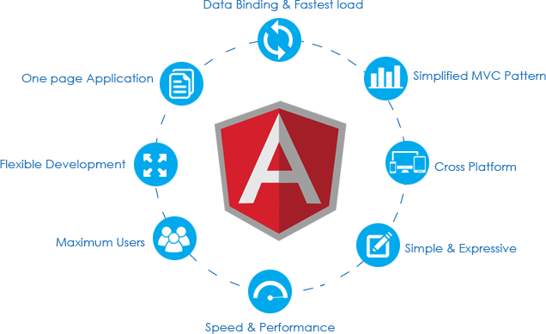
Technologies
AngularJS lets you extend HTML with HTML attributes called directives
AngularJS provides built-in directives and user defined directives
<number>
Notes:
<number>

Slide 10

Technologies
Node.js is an open source server environment
Node.js runs on various platforms (Windows, Linux, Unix, Mac OS X, etc.)
Node.js uses JavaScript on the server
<number>
Notes:
<number>

Slide 11
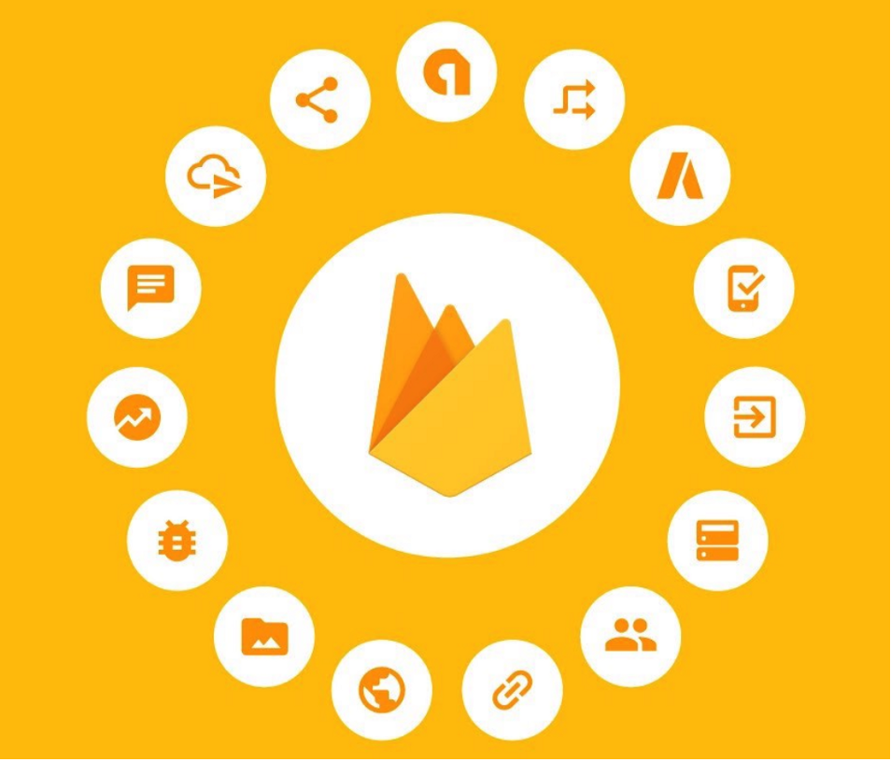
Technologies
Firebase is a mobile and web app development platform that provides developers with a plethora of tools and services to help them develop high-quality apps, grow their user base, and earn more profit.
<number>
Notes:
<number>

Slide 12

Technologies
MySQL, the most popular Open Source.
SQL database management system, is developed, distributed, and supported by Oracle Corporation
<number>
Notes:
<number>

Slide 13
conclusion
Achieve results:
Built the web system satisfies requirements.
New technologies: Node JS, Firebase database, Angular framework, Git.
<number>
Notes:
<number>

Slide 14
conclusion
Disadvantages:
Cannot send message to the user’s phone
Cannot book the gridiron on the internet.
Can not track the available gridirons
<number>
Notes:
<number>

Slide 15
conclusion
Future work:
Send a message to the user’s phone.
Tracking and booking gridiron on the internet
<number>
Notes:
<number>

Slide 16
Demonstration
<number>

Slide 17
QUESTION & ANSWER
<number>

Slide 18
THANK YOU
<number>

